Slide 1
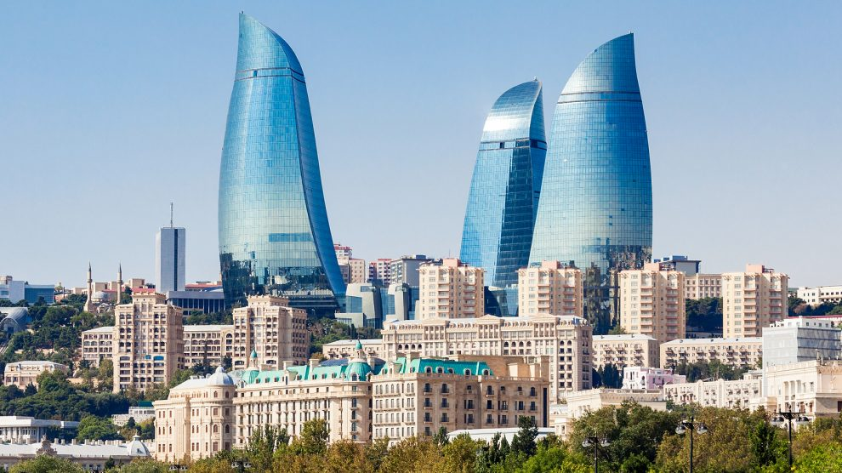
AZERBAIJAN
ICT INFRASTRUCTURE
SDGS: GOAL 9
CHANHEE KIM
DOJIN SIM
JIHUN GWAK

Slide 2
1.Motivation
2.Azerbaijan
3.Problems & Solutions
4.Outcomes & impact & challenges

Slide 3

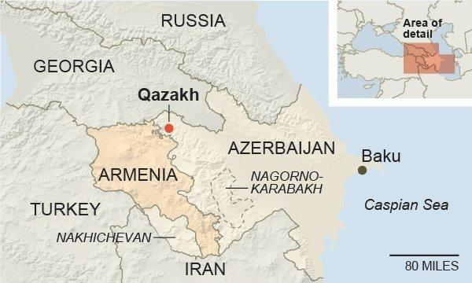

The Armenia-Azerbaijan War

Slide 4
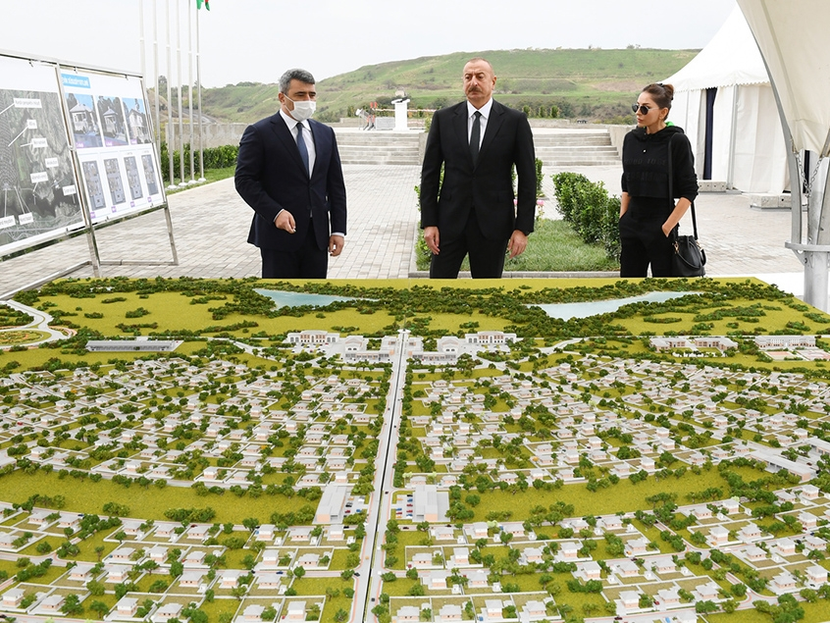
Azerbaijan
The Armenia-Azerbaijan War
Azerbaijan prepares for Karabakh resettlement in “smart villages”

Slide 5
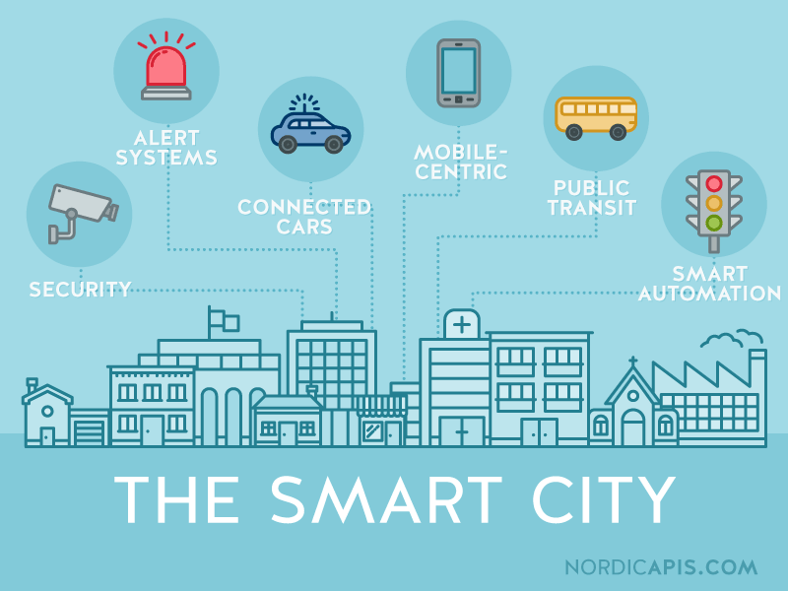

Azerbaijan & SDG9
resilient infrastructure, promote sustainable industrialization, and foster innovation

Slide 6
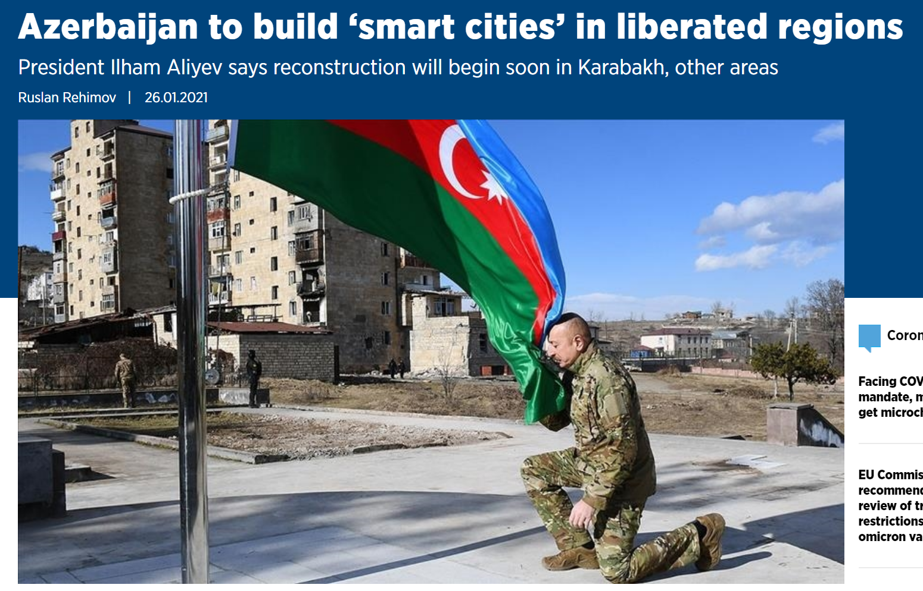
Azerbaijan & SDG9
automation including cold & heat resistant homes, management of household waste, or the installation of hydro and solar energy station

Slide 7

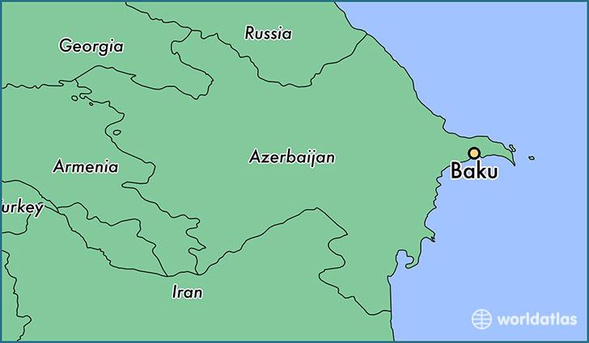
Azerbaijan & SDG9
in established cities in Azerbaijan the situation is different

Slide 8
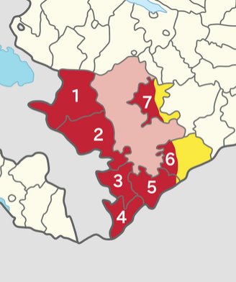
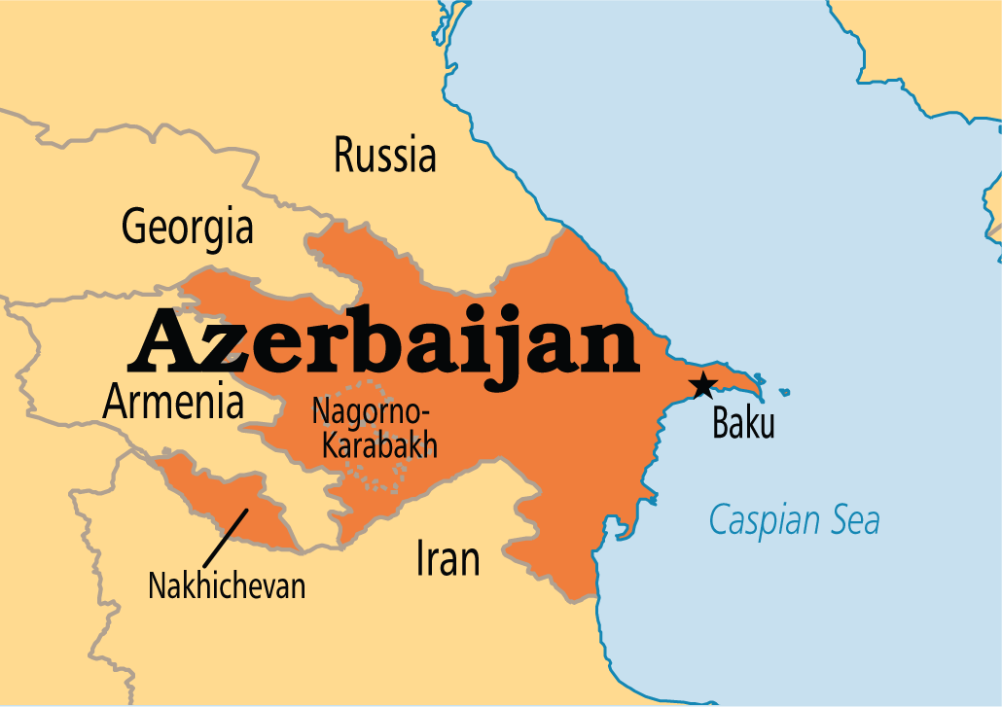
Azerbaijan
Baku is the capital and largest city
following the 2020 Nagorno-Karabakh war, the seven districts were returned to Azerbaijan control.
10 million people
post-Soviet transition into a major oil-based economy
GDP per capita is about 42.60 billion dollars

Slide 9
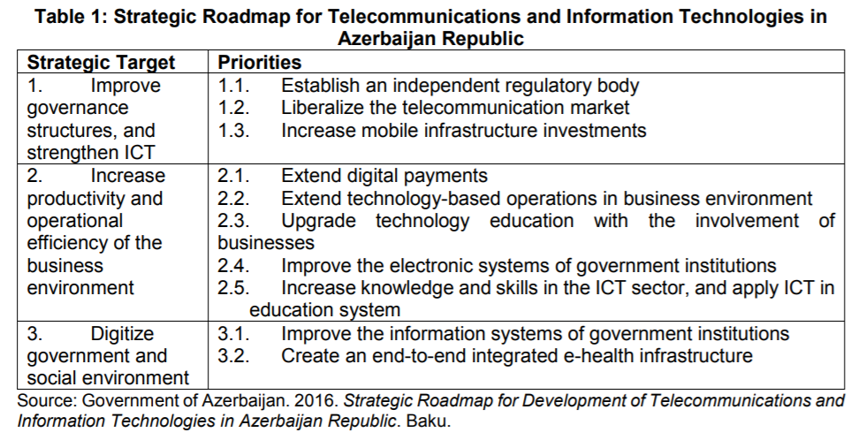
Azerbaijan & ICT Road Map

Slide 10
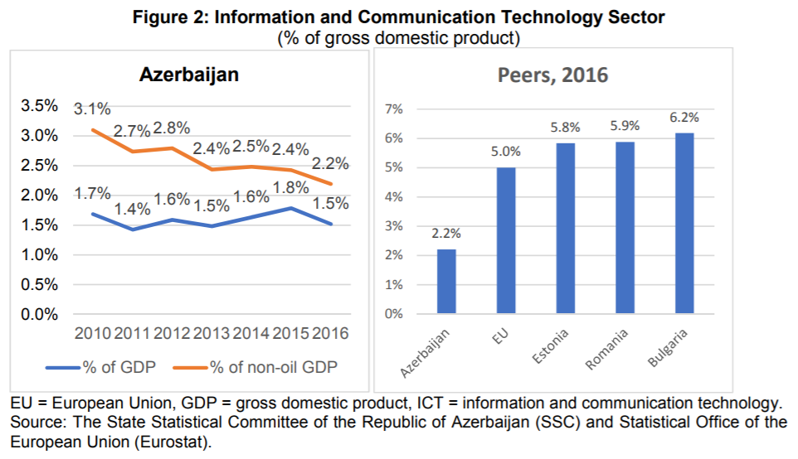
Azerbaijan & ICT Road Map
No integrated approach
combining traffic,
weather,
public sanitation,
and sensors with
public safety information

Slide 11


Slide 12
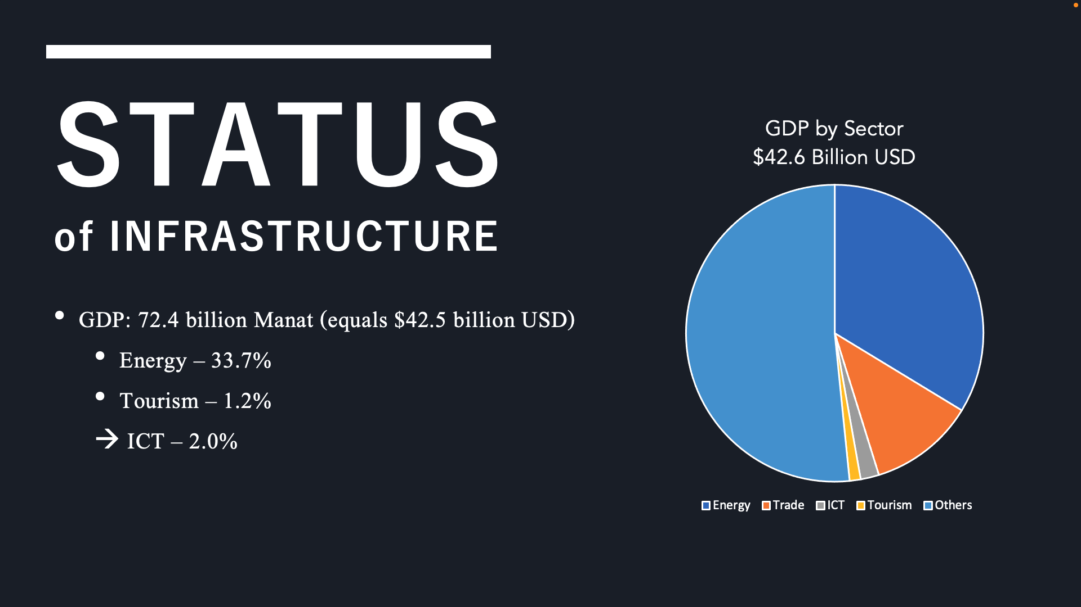

Slide 13


Slide 14
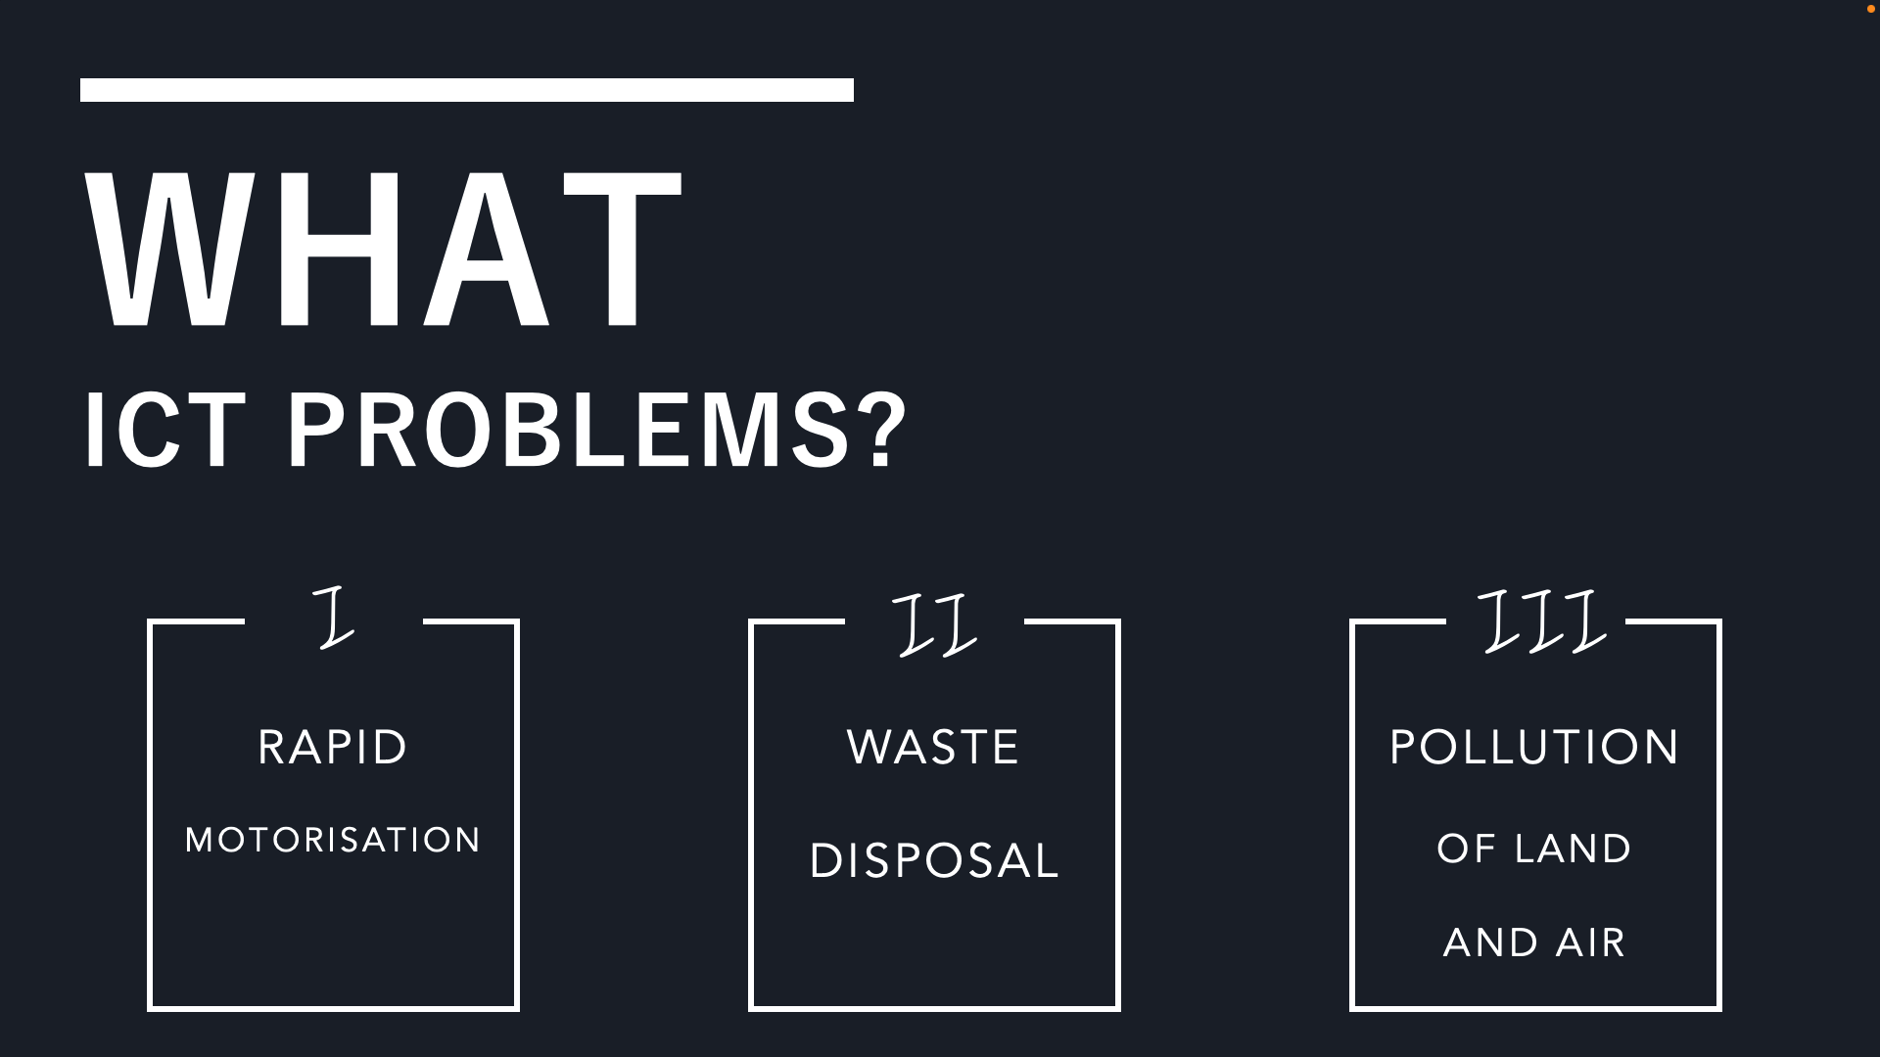

Slide 15
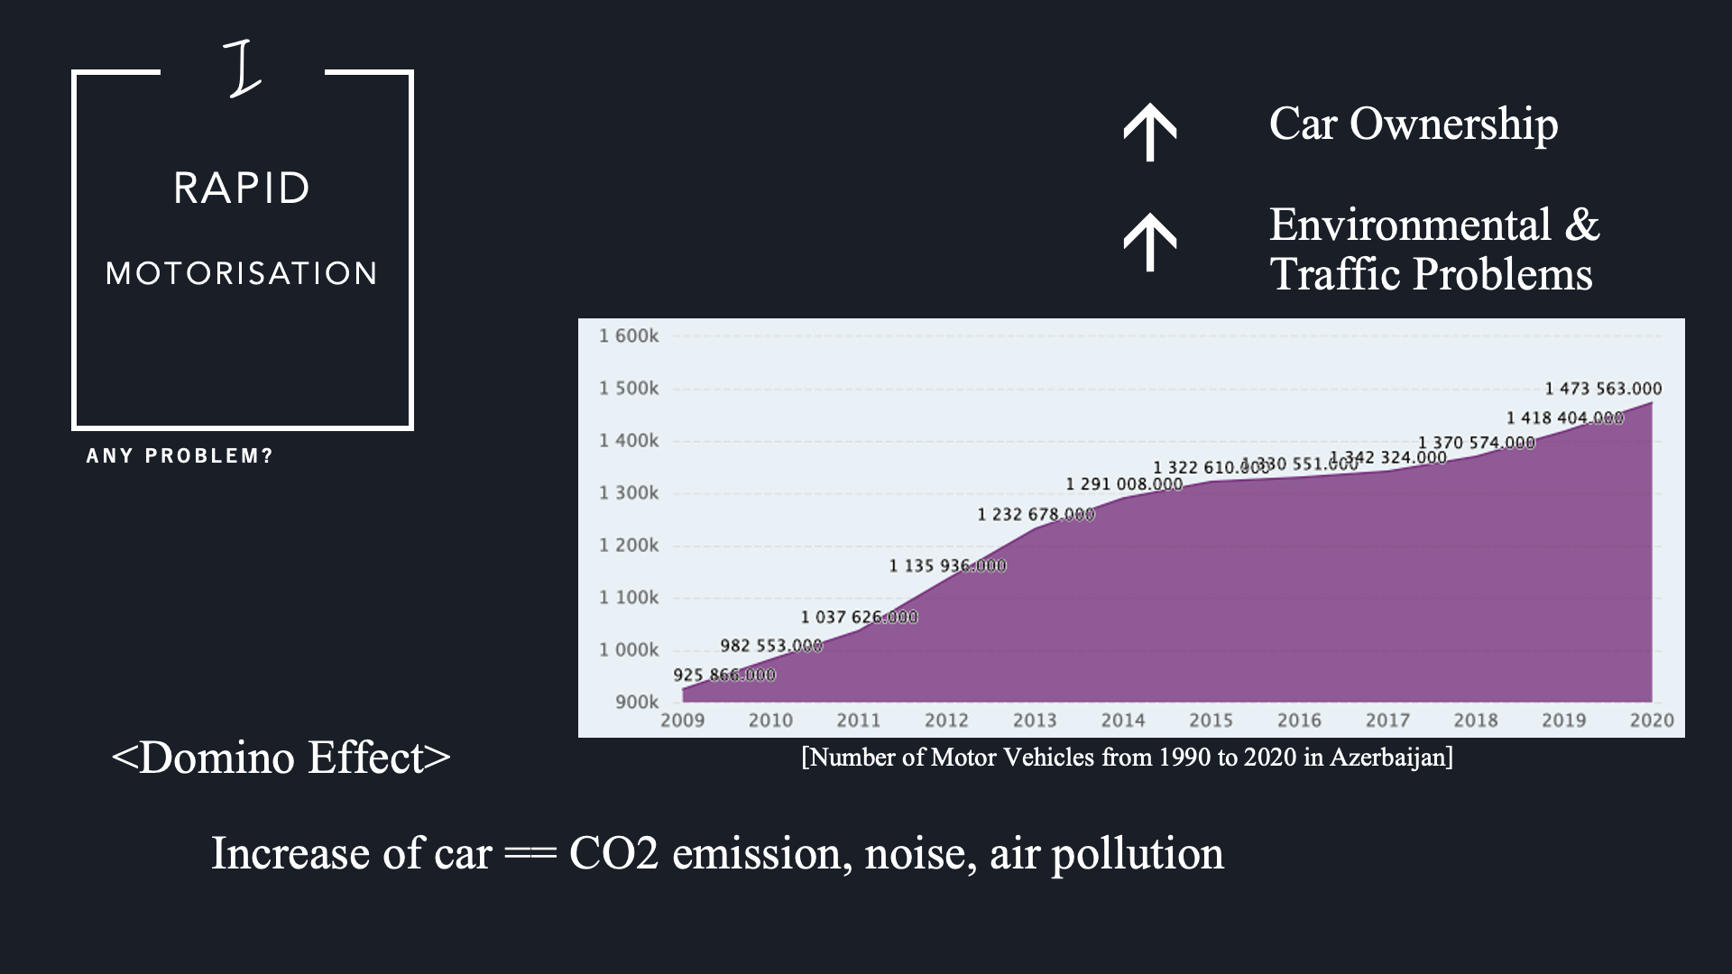

Slide 16
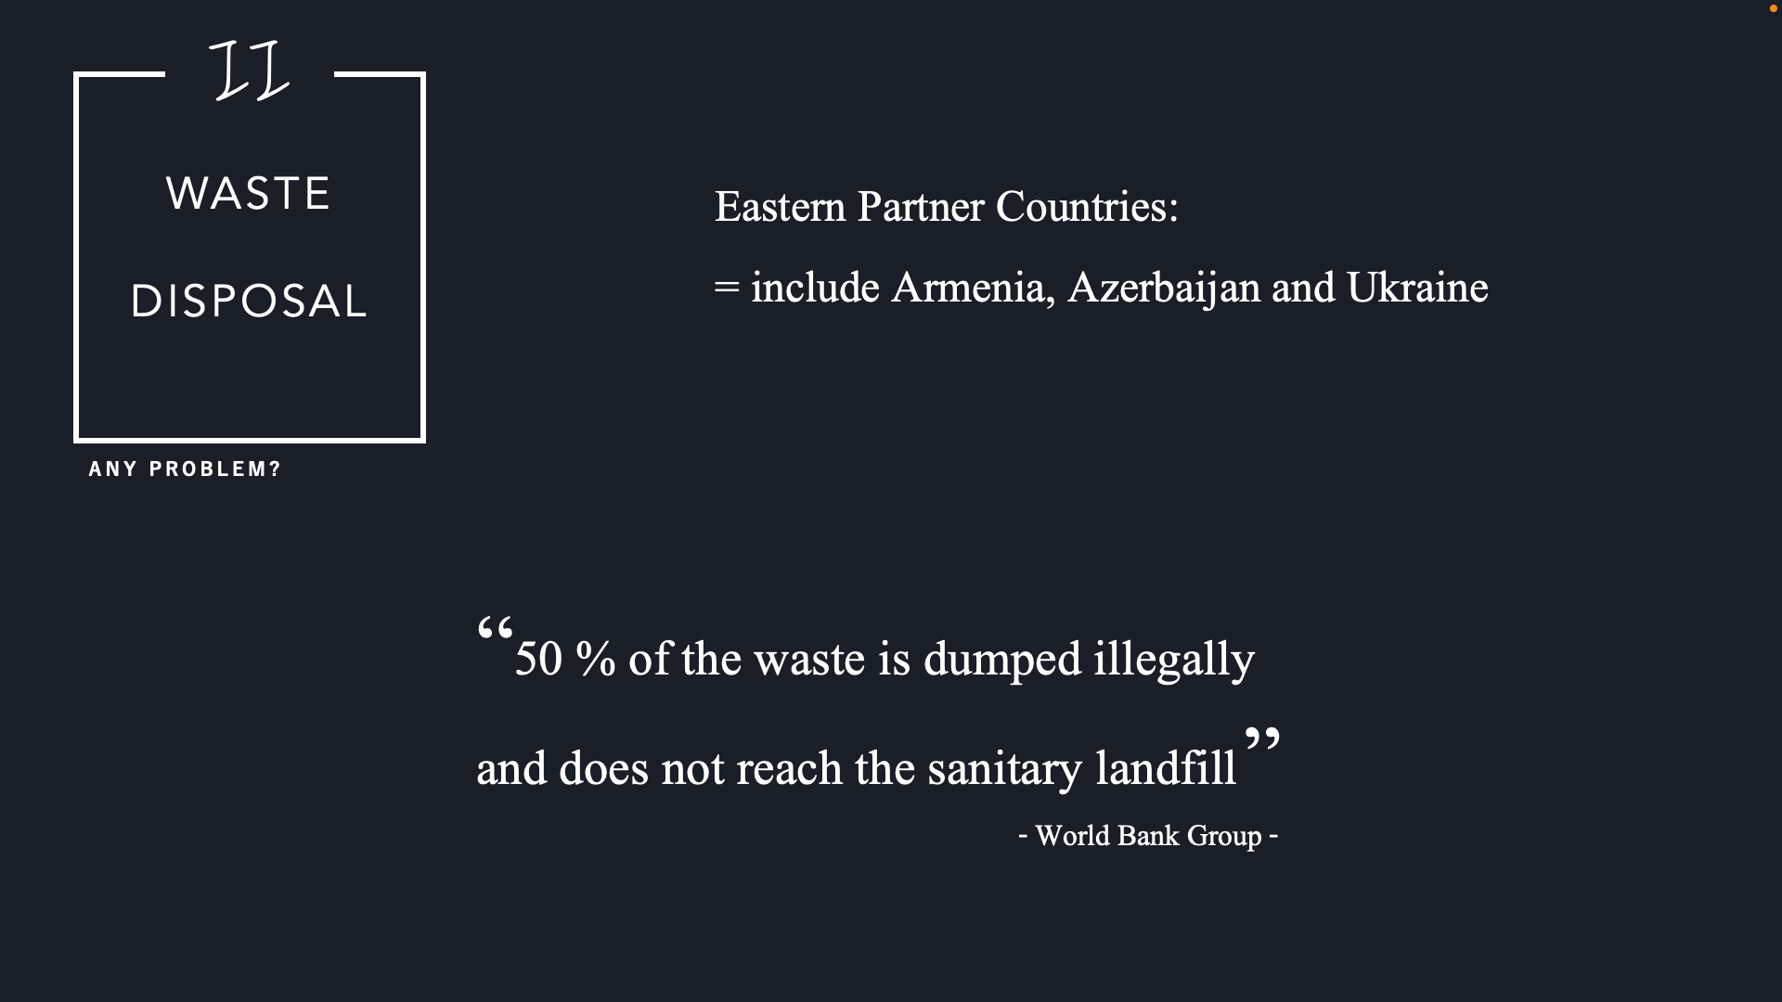

Slide 17
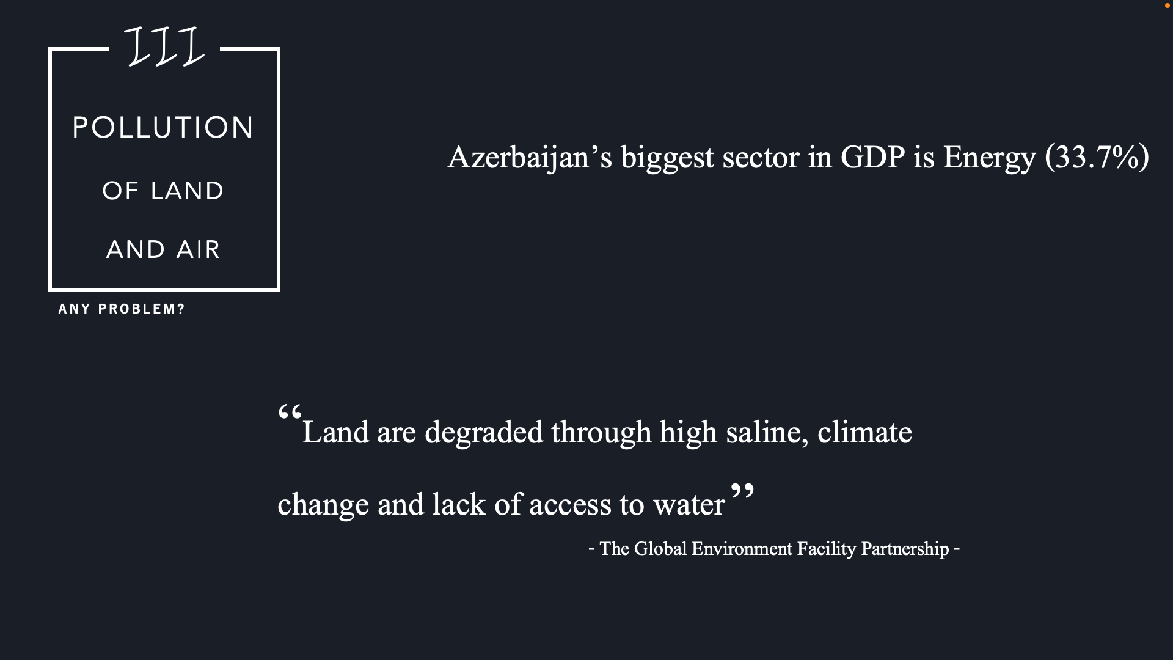

Slide 18
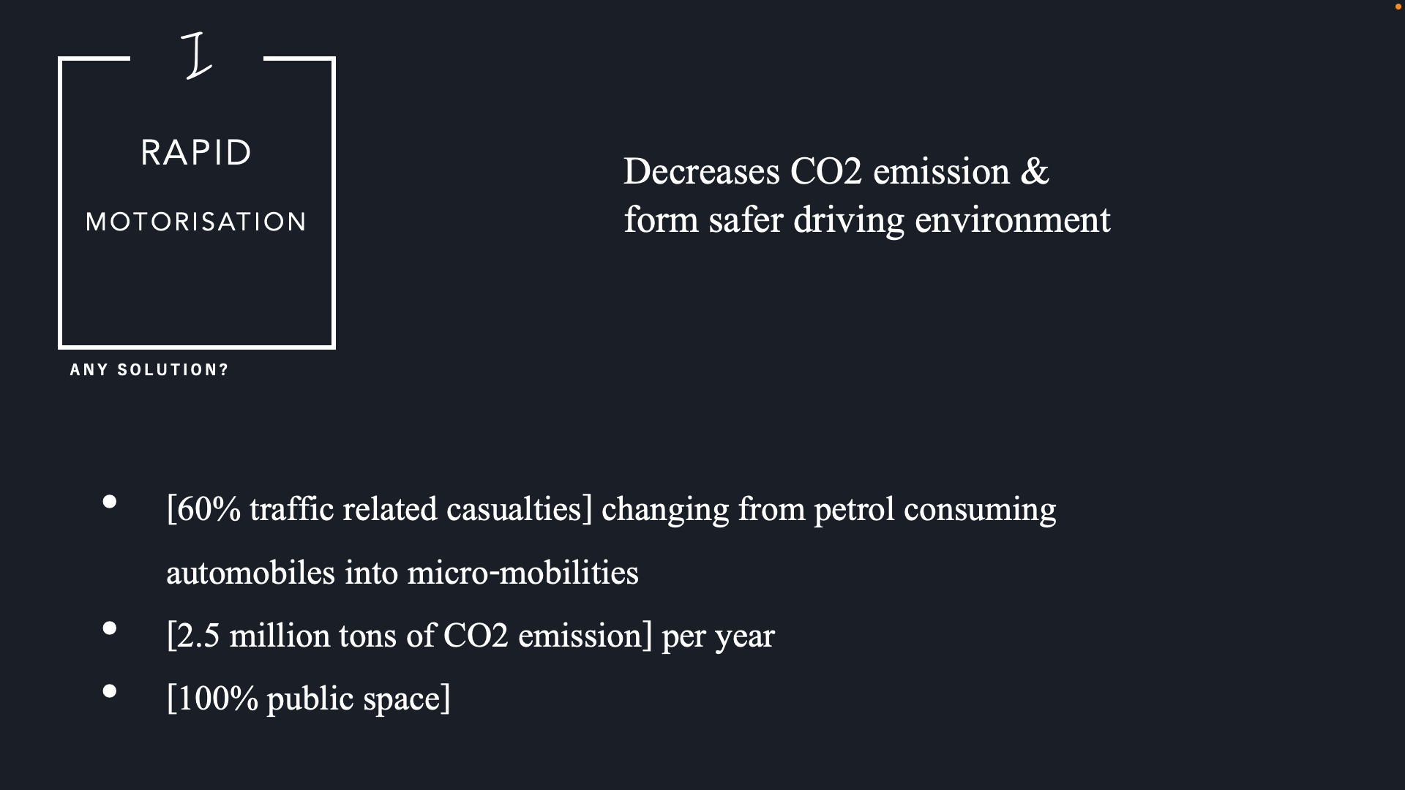

Slide 19
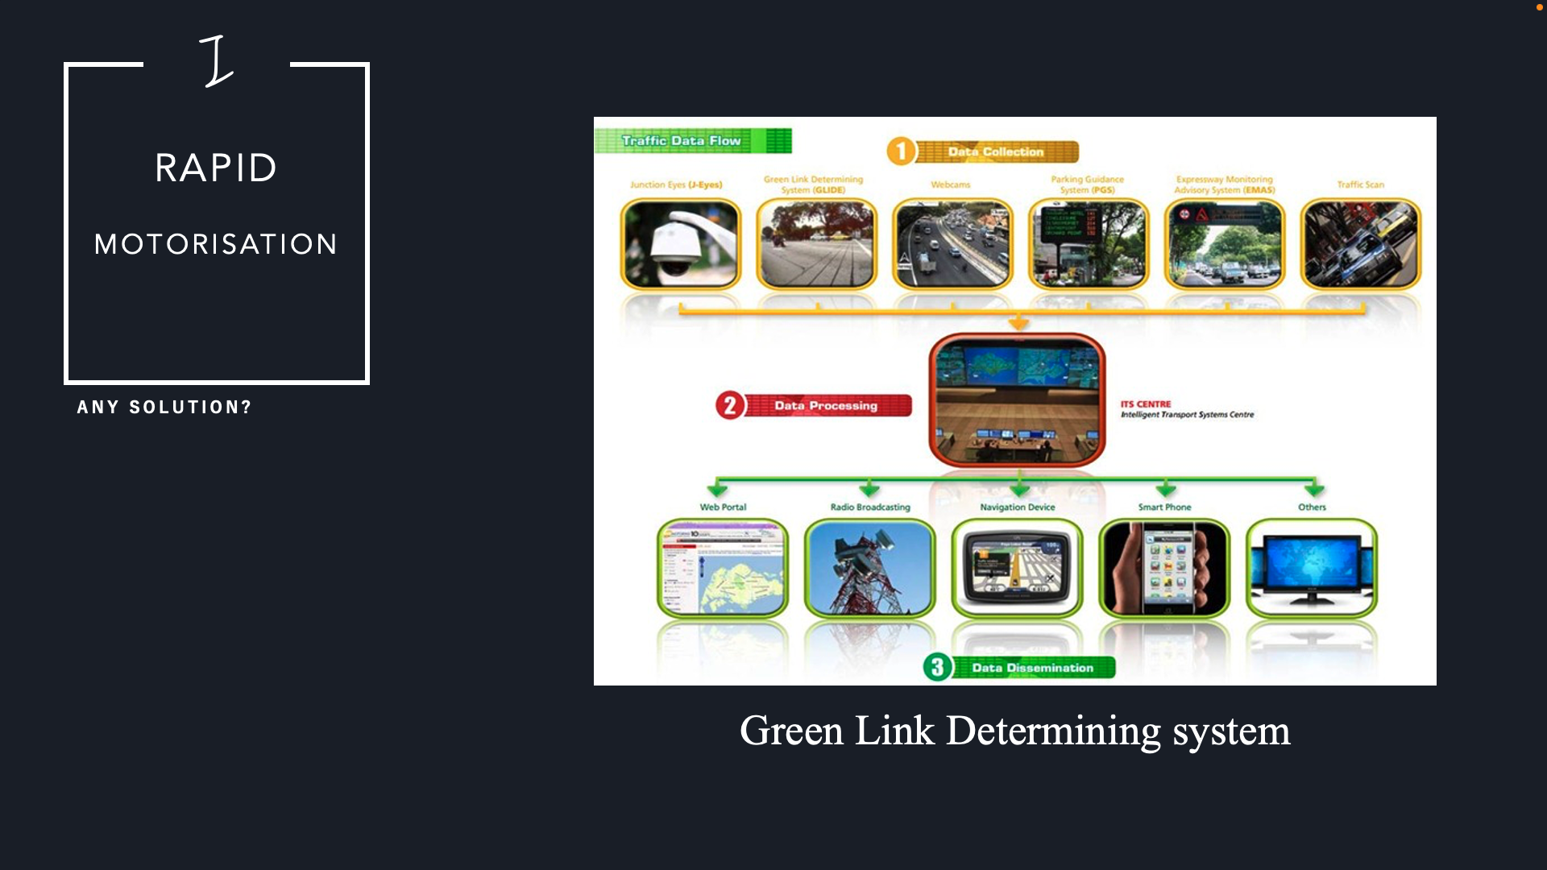

Slide 20
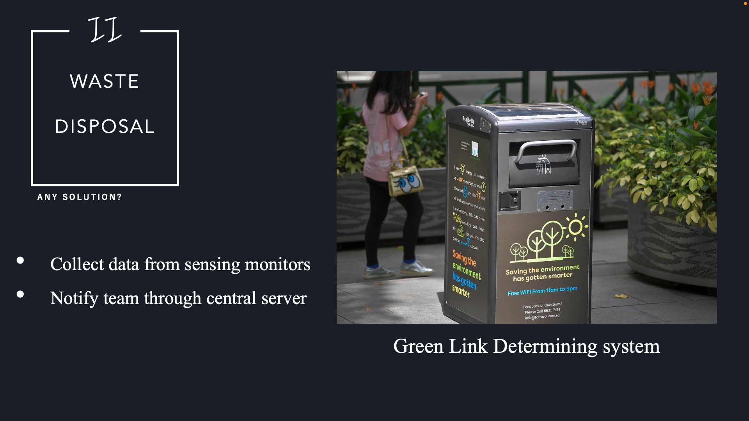

Slide 21
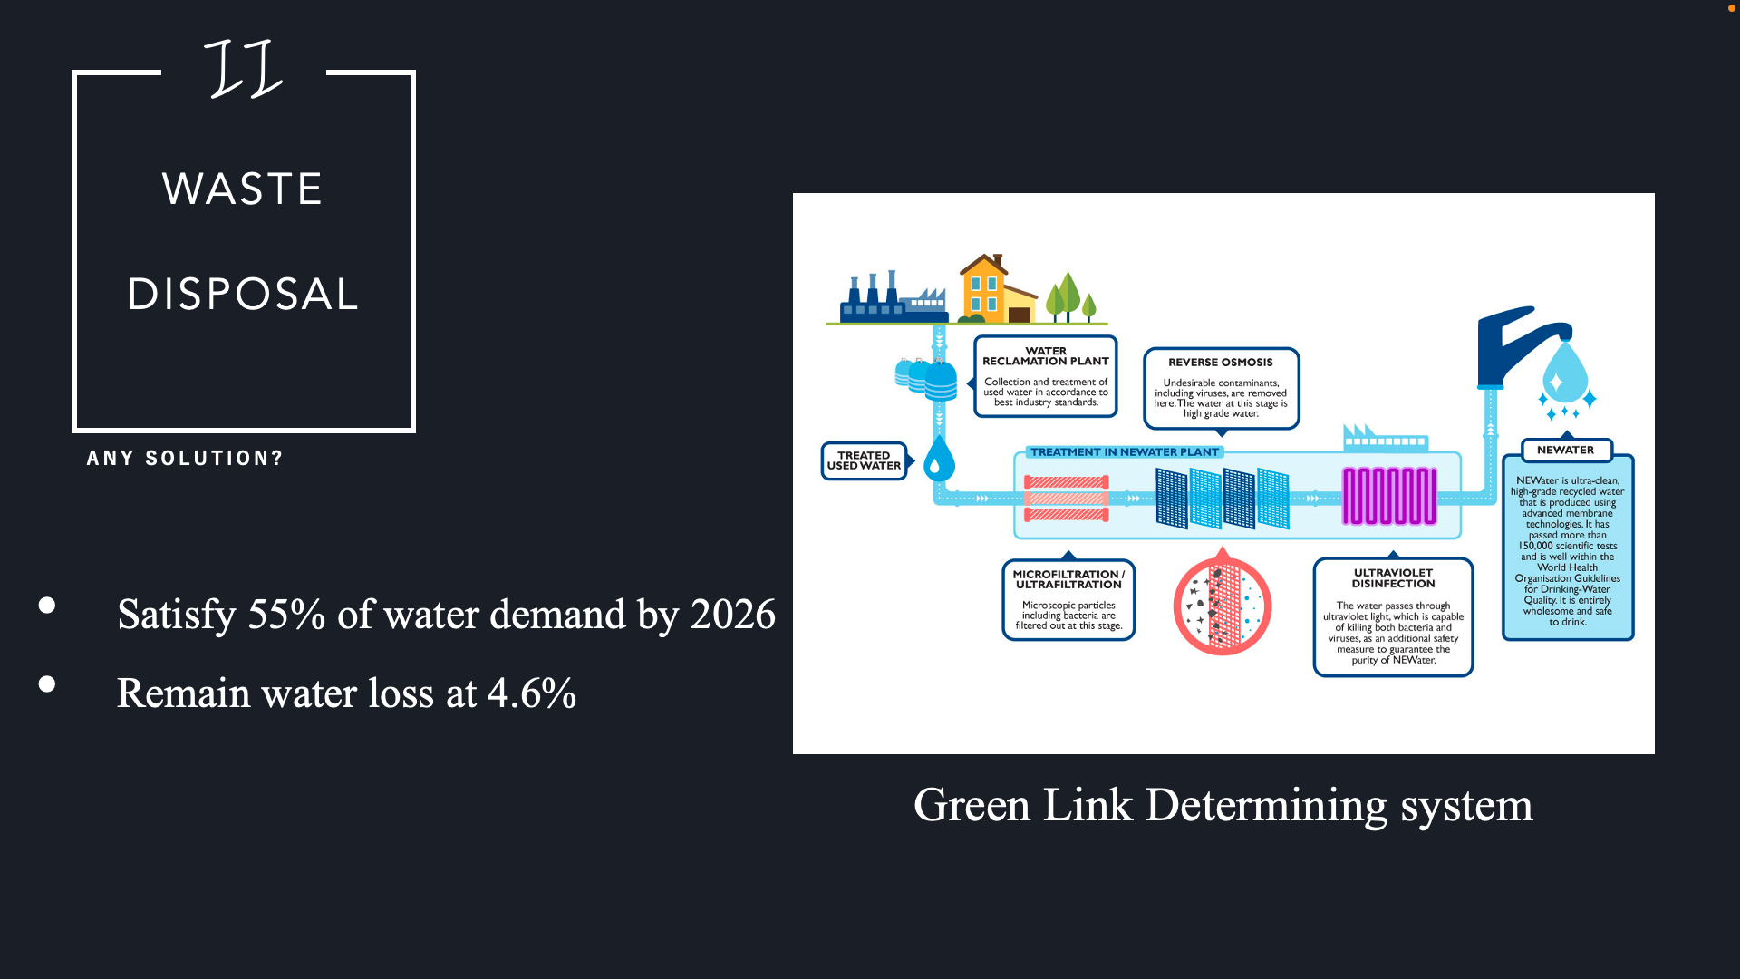

Slide 22
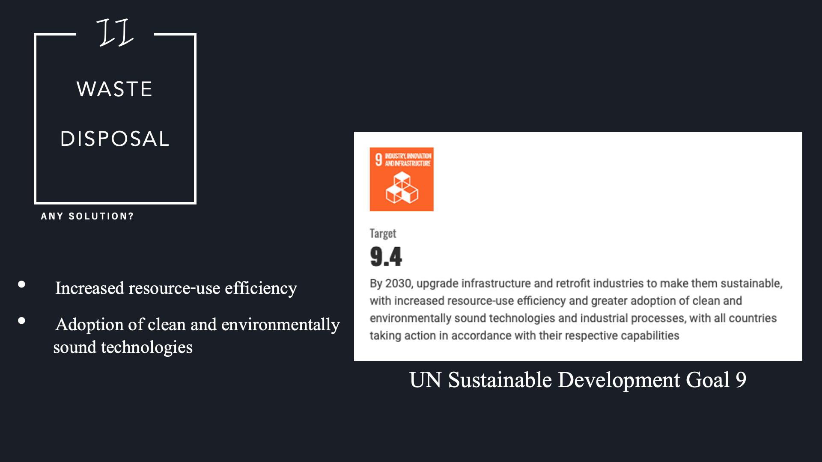

Slide 23
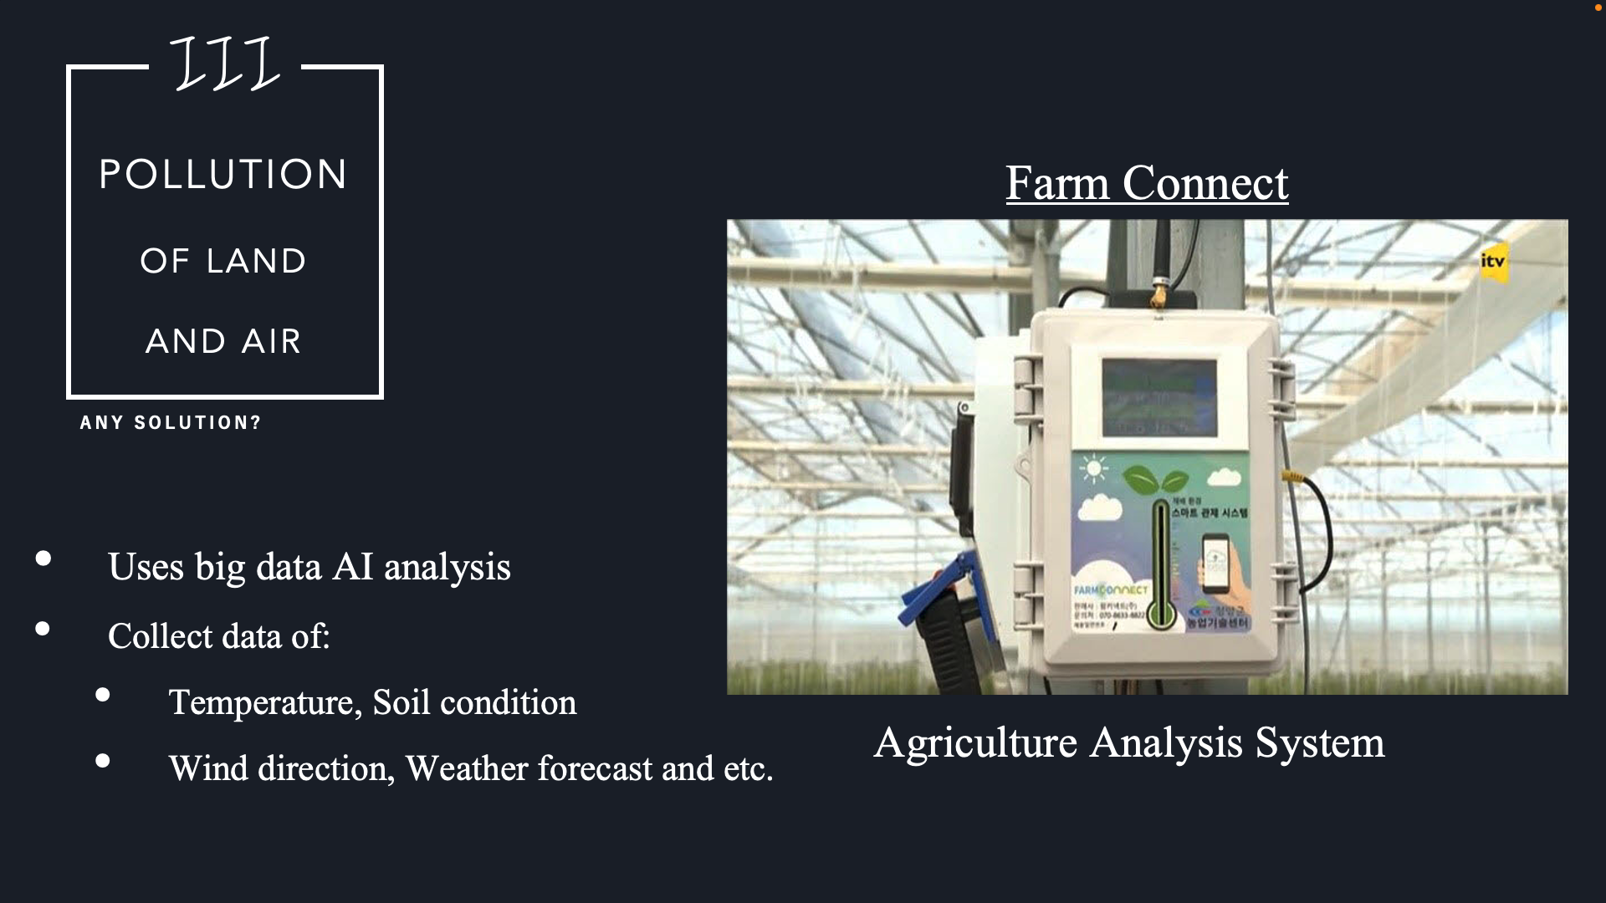

Slide 24
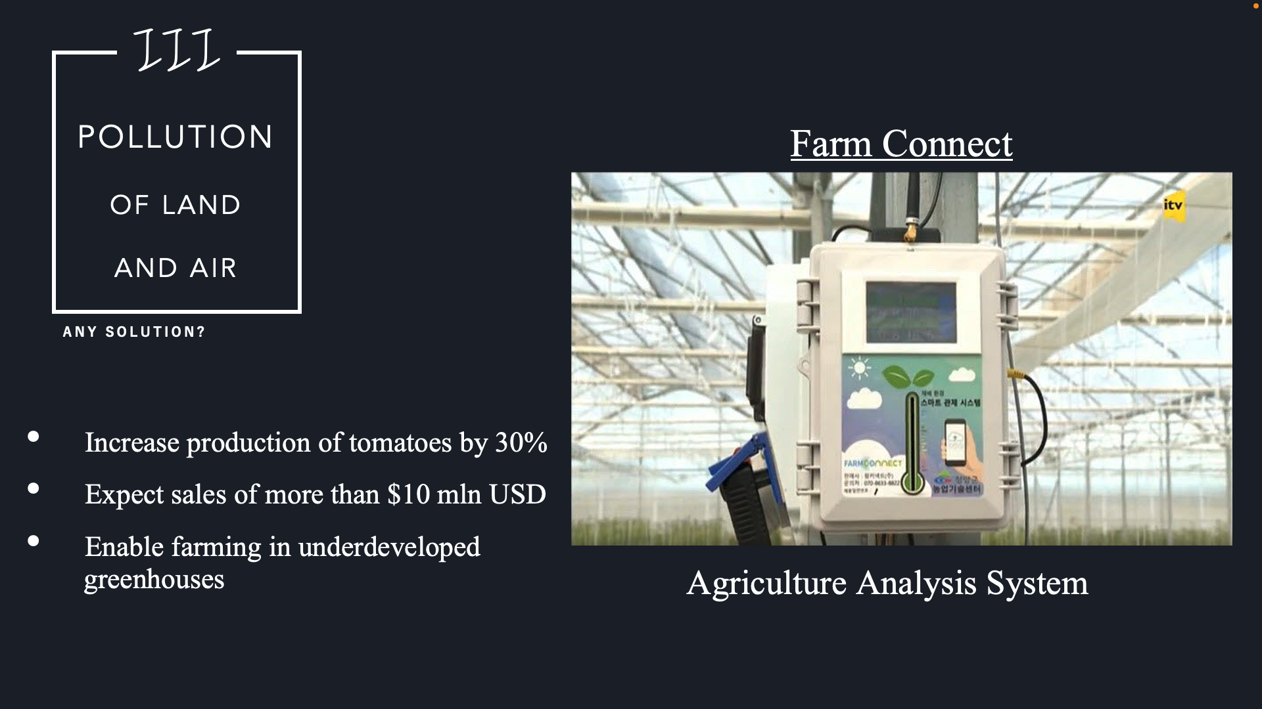

Slide 25
Challenges
?

Slide 26
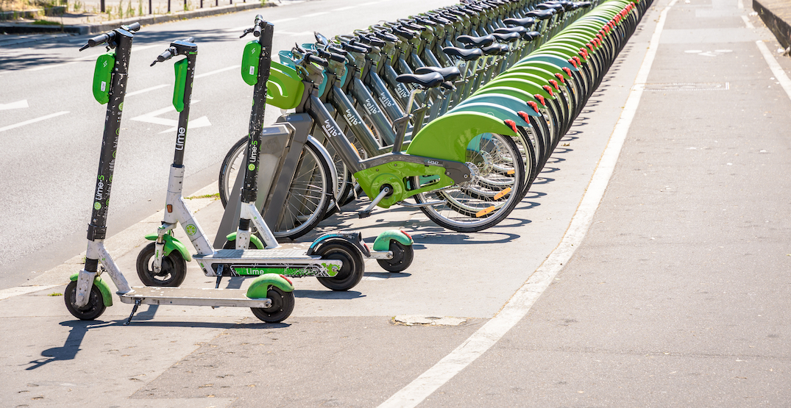
Transportation Transformation
E-Shared Bicycles and Electric Scooters

Slide 27

Transportation Transformation
Doubles every year
1242 Reported illegal cases a day
Injuries that lead to 2~12 weeks to recover for pedestrians
“Kick Elks”
“E-scooter accidents in Seoul rise sharply over past 3 years”
(2018~2020)

Slide 28
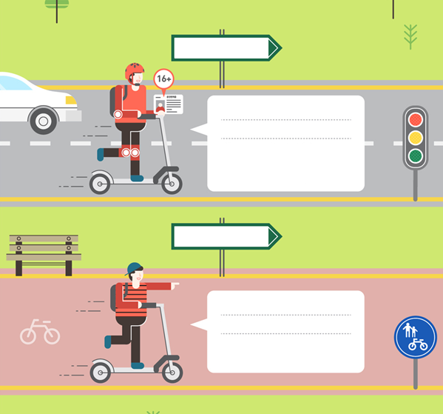
Transportation Transformation
According to the regulation
Purpose: Public Transportation
Driving Area: Road
Requirements: Over 16 years old
Driver’s License
Protective equipment
Enforce regulations
Education required
Reality
Purpose: Leisure, Fun rides
Driving Area: Sidewalk, Bicycle road
Requirements: None

Slide 29


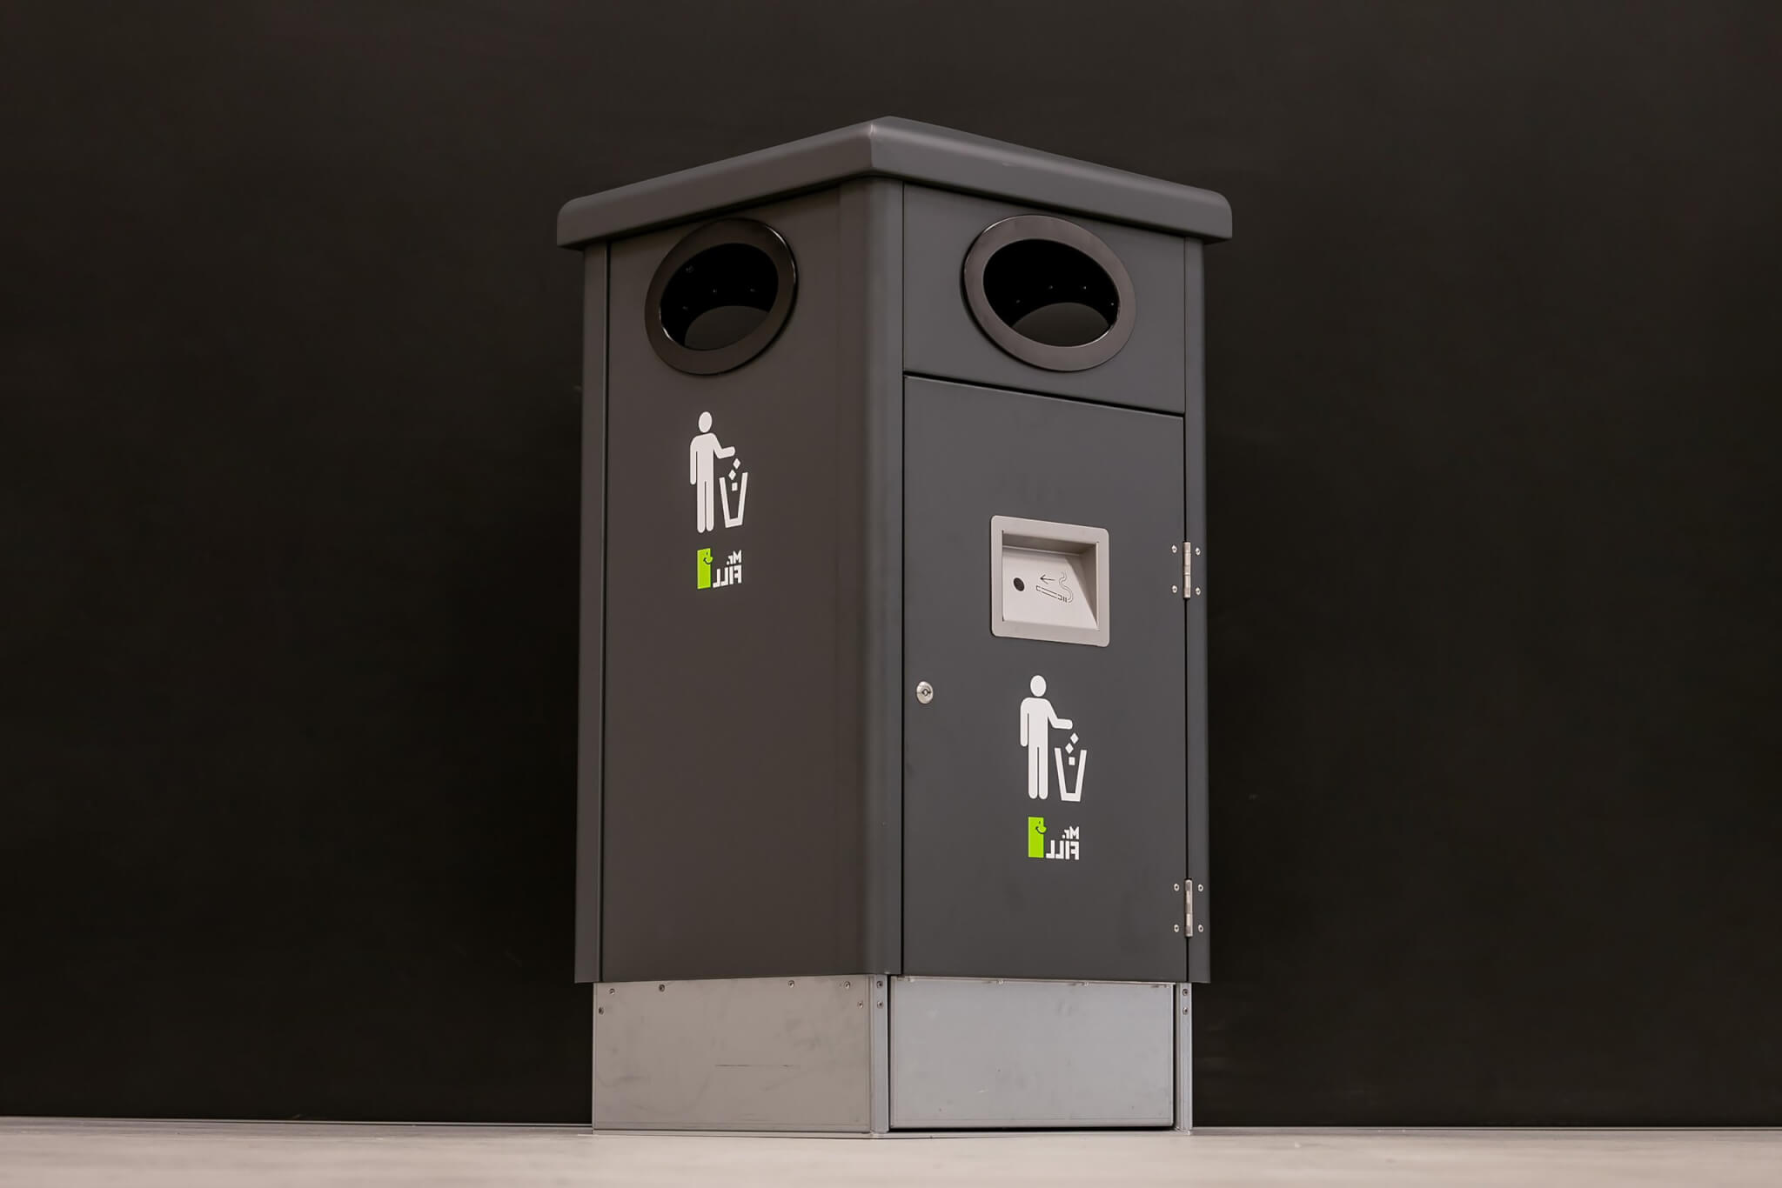
Waste Disposal
+
=

Slide 30

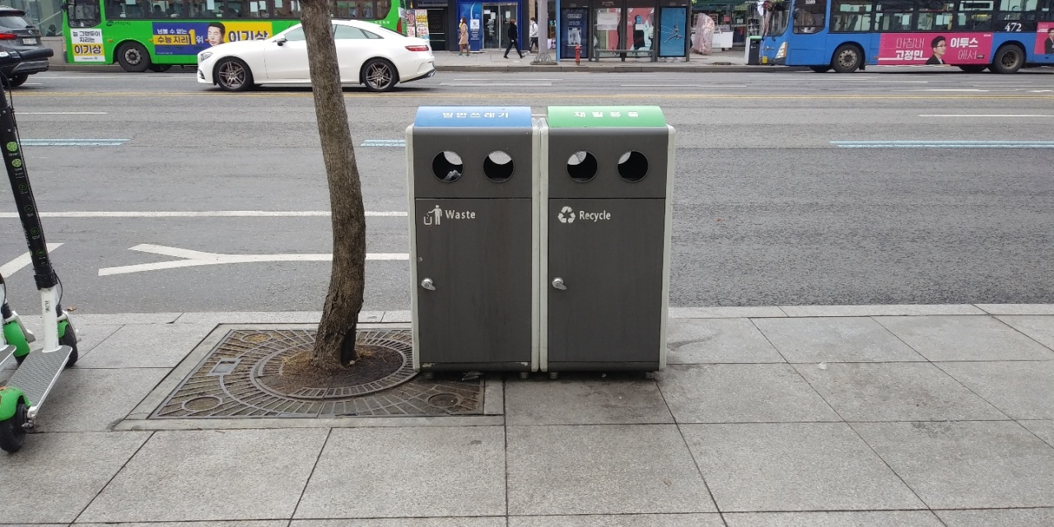
Waste Disposal

Slide 31
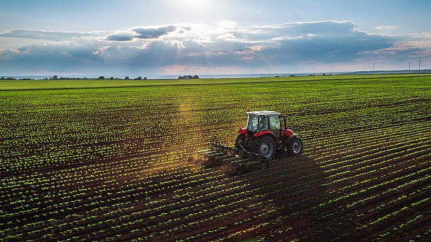
Agriculture
Employing 37% of the population
One of four priority sectors for diversifying the economy
Require higher education
Increase unemployment rate

Slide 32
Conclusion
!

Slide 33
THANK YOU FOR LISTENING
EST 372
PRESENTATION

